Slide 1
G481/581 Terrestrial Ecosystem Modeling Energy Budgets in TEMs
Instructor: Dr Natasha MacBean

Slide 2
Overview
Focus on Ch 7 of Bonan textbook
Planetary energy budget overview
Role of GHGs in warming planet
Surface energy budget overview
Component fluxes:
Net radiation → role of albedo
Sensible heat flux
Latent heat flux
Soil heat flux
Canopy storage
Factors that modulate energy fluxes (surface temp, soil moisture, conductance/roughness/wind)
Temporal and spatial variation
Generalization from bulk surface to canopy
How we model the component energy fluxes
Model evaluation
Issues with eddy covar data (and satellite data)
* Denotes aspects you can focus on in more depth in class project (e.g. examining how processes differ across models)

Slide 3
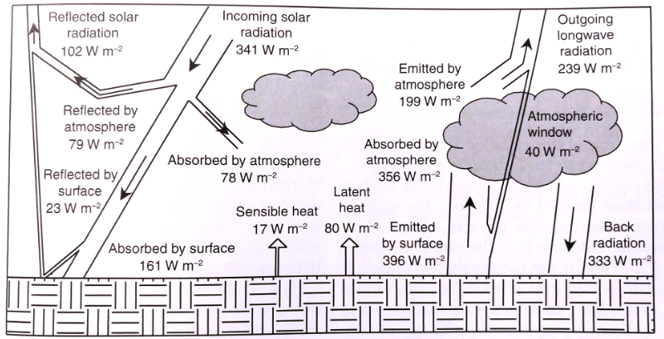
Planetary Energy Balance
Bonan (2016) Fig. 3.2
Notes:
Averaged over a year, incoming solar radiation absorbed by earth is balanced by longwave radiation emitted to space.
Change of water between solid, liquid and gaseous forms provide energy → fuels convection, atmospheric circulation, storm formation
Atmospheric gases (CO₂, CH₄, N₂0) react with outgoing radiation → affect planetary energy budget.
→ These gases cycle among earth systems – regulated by biogeochemical processes.
→ Human activities modify these processes and cycles, thus also affecting planet’s energy balance.

Slide 4
Surface Energy Balance
Net radiation balanced by surface fluxes
R_{n} = (S↓ - S↑) + (L↓ - L↑) = H + E + G + storage
Canopy storage
Net radiation
Incoming shortwave radiation from sun
Latent heat flux / evapotranspiration
Outgoing longwave radiation → re-emitted by surface
Soil heat flux stored in soil
Outgoing shortwave radiation → reflected by surface
Incoming longwave radiation → re-emitted by atmosphere trapping gases
Change in heat storage
Sensible heat flux
S↓ and L↓ are inputs to model (climate forcing)
All fluxes have units of Wm⁻²
Notes:
Net radiation dissipated in three ways: sensible heat flux (movement of air transports heat through convection; latent heat flux/evapotranspiration (as water changes from liquid to vapor it requires considerable energy which is absorbed from surface and transferred to atmosphere); storage and transfer of heat through 3d surface (e.g. soil heat flux) through conduction.
E = evaporative water flux; lamda is latent heat of vaporization

Slide 5
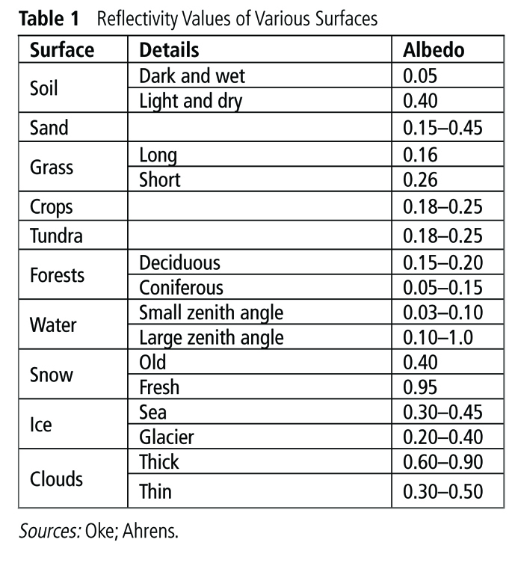
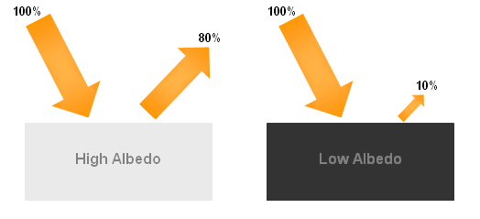
Reflected shortwave radiation and Role of Albedo
S↑ = 𝜌_{s} S↓
Surface reflectance (albedo)
Affects net radiation R_{n} available at surface
Albedo defined as a parameter in models depending on surface type (leaf vs soil), snow age etc*

Slide 6

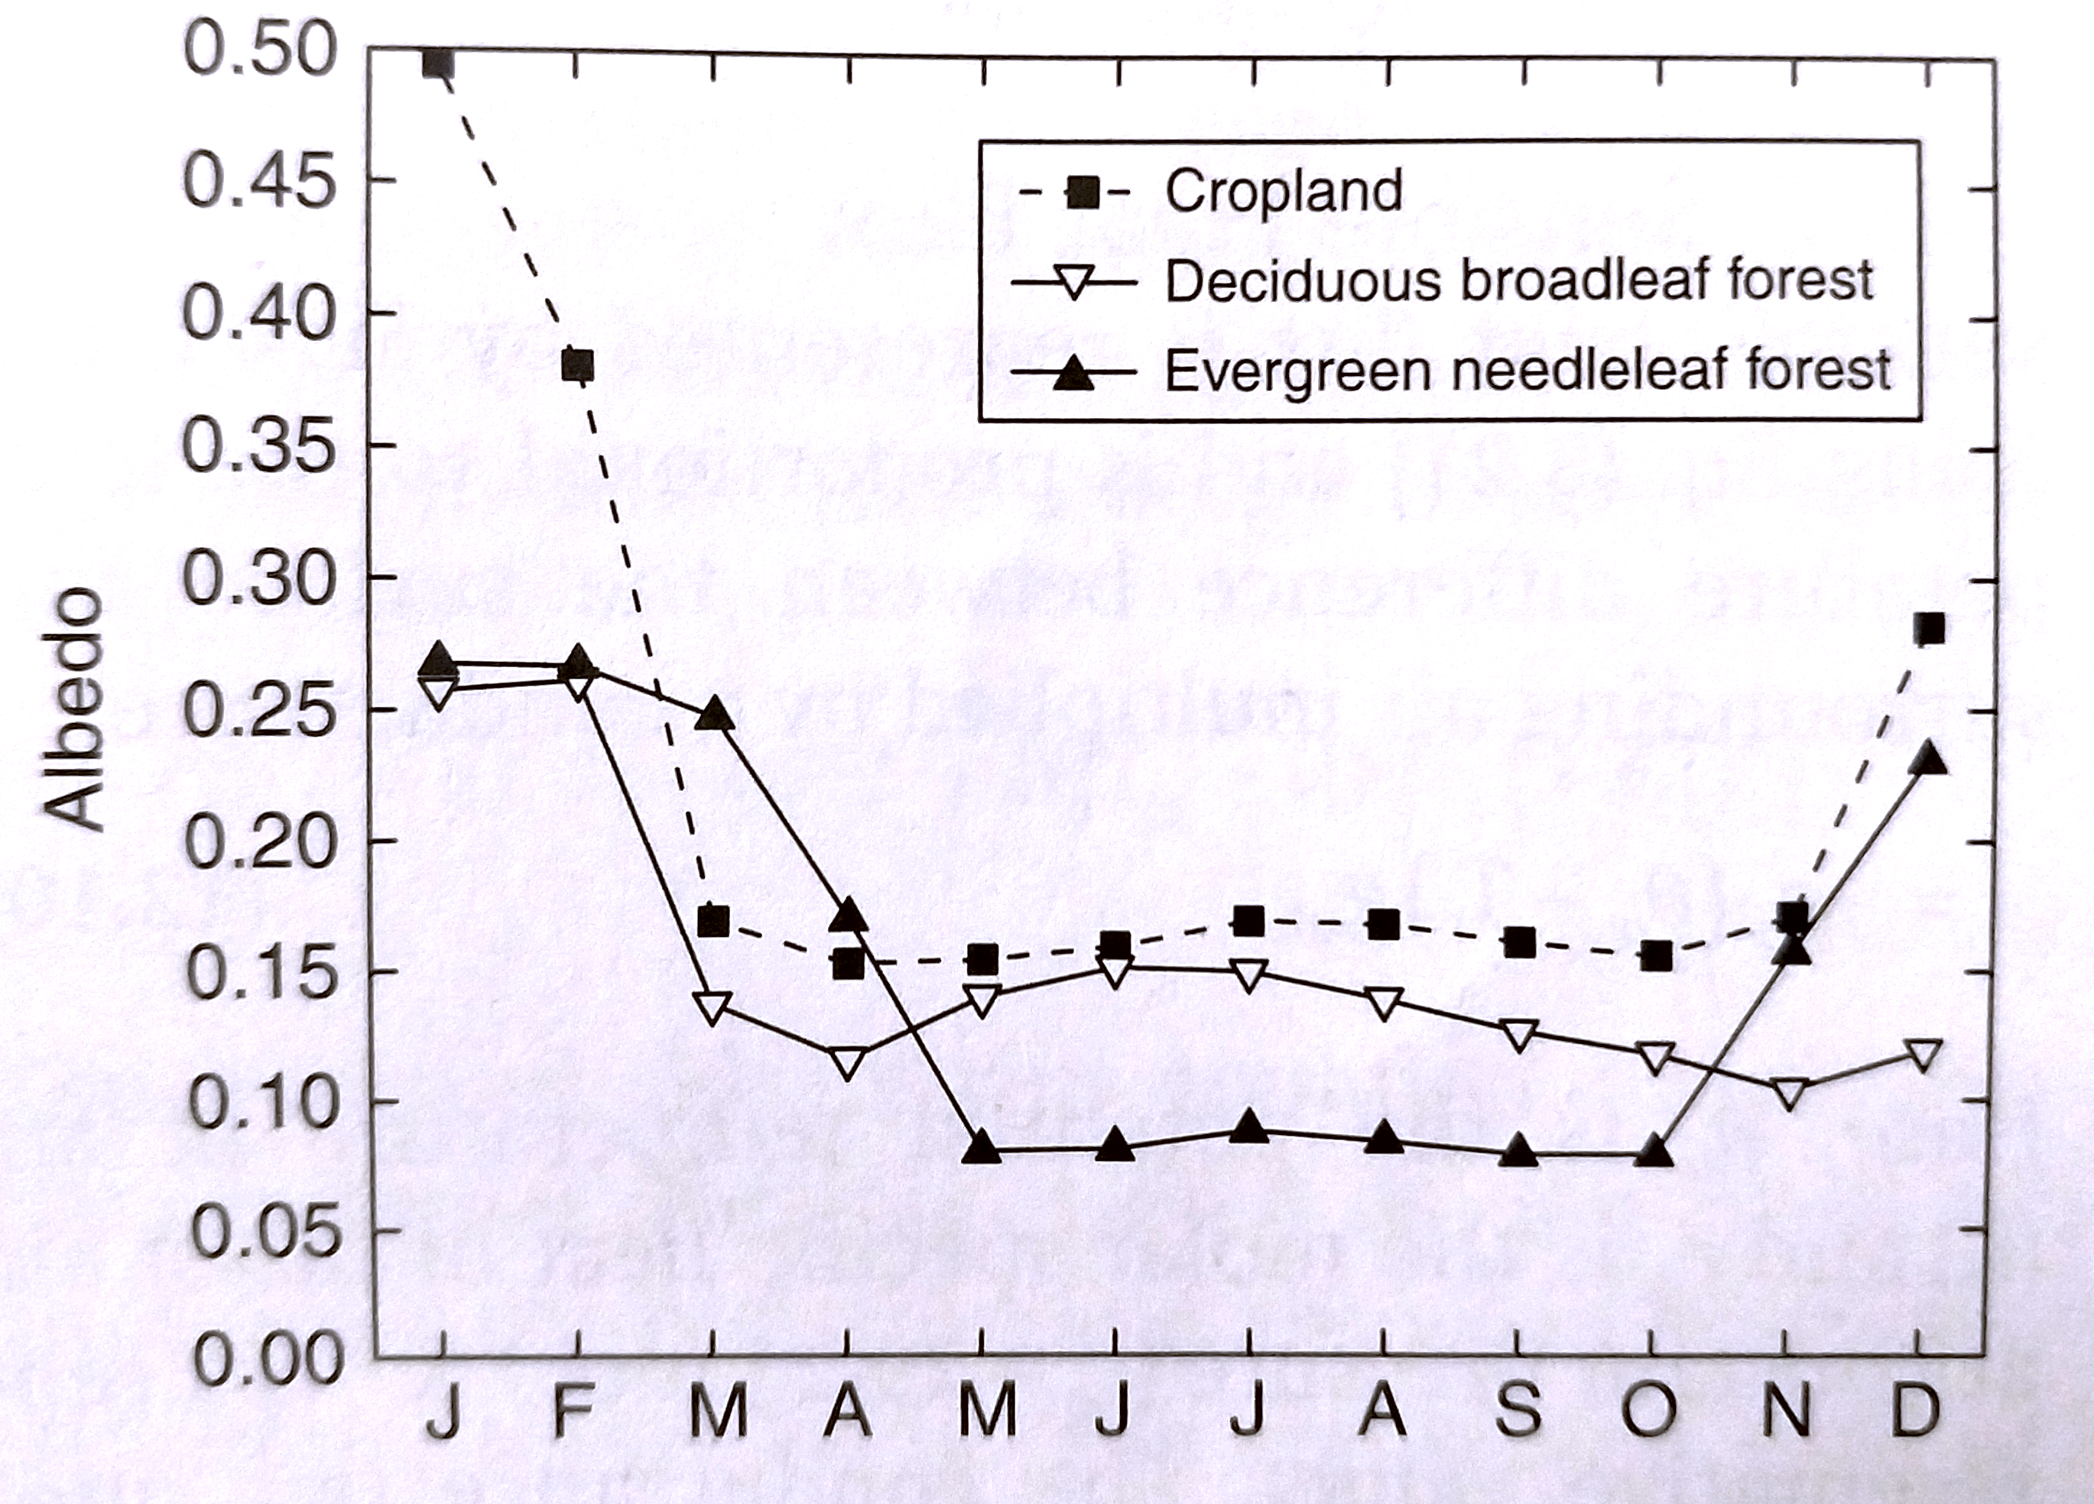

Role of Albedo
Varies*:
By Wavelength
Over course of day and year
By vegetation type
Be soil particle size and wetness
Deforestation changes albedo

Slide 7
Outgoing longwave radiation
L↑ = 𝜀𝜎T_{s}⁴ + (1-𝜀)L↓
Emissivity of surface (or its absorptivity)
Radiation simply reflected by surface
Surface temp
Stephan-Boltzmann constant
Affects net radiation R_{n} available at surface
𝜀 and 𝜎 are constants → 𝜀 varies by surface type
and Ts and L ↑ are calculated variables

Slide 8
Sensible Heat Flux (H)
c_{p} = molar specific heat of moist air at constant pressure
T_{s} = surface temperature (skin temp)
T_{ref} = potential temperature of parcel of air at reference height above ground (e.g. 2m)
g_{ac} = aerodynamic conductance*
H = c_{p}(T_{s} – T_{ref})g_{ac}
Heat flux due to temperature differences
Follow Fick’s laws of diffusive fluxes
Notes:
Turbulence occurs when wind flows over surface and mixes up air – this is greater with rougher surfaces as they exert more drag on moving air parcels
Process that drives convection

Slide 9


Sensible Heat Flux (H)
c_{p} = molar specific heat of moist air at constant pressure
T_{s} = surface temperature (skin temp)
T_{ref} = potential temperature of parcel of air at reference height above ground (e.g. 2m)
g_{ac} = aerodynamic conductance*
H = c_{p}(T_{s} – T_{ref})g_{ac}
Heat flux due to temperature differences
Follow Fick’s laws of diffusive fluxes
Driven by temperature difference between surface and air
Surface loses energy if its T_{s} is warmer than air and vice versa
Aerodynamic conductance depends on atmospheric turbulence driven by surface roughness (height of vegetation, leaf area and heterogeneity)
c_{p} parameter
Others are variables → but how surface roughness parameterized differs across models and their complexity*
Notes:
Turbulence occurs when wind flows over surface and mixes up air – this is greater with rougher surfaces as they exert more drag on moving air parcels
Process that drives convection

Slide 10
Latent Heat Flux (E, also LE or λE)
q_{sat} = vapor pressure of saturated surface at surface temp
q_{ref} = vapor pressure of air at reference height
T_{s} = surface temperature
g_{ac} = aerodynamic conductance
g_{c} = surface (or canopy) conductance*
E = q_{sat} (T_{s}) – q_{ref}
g_{c}⁻¹ + g_{ac}⁻¹
Moisture and heat flux related to evaporation
Also follows Fick’s laws of diffusive fluxes
Affects surface and air temperatures because of energy needed to evaporate water → latent heat of vaporization
Notes:
VPD between surface saturated with moisture and air. Saturation VPD increases exponentially with surface temp; therefore, E/ET increases as Ts increases.
Different formulations of ET in different models*

Slide 11
Latent Heat Flux (E)
q_{sat} = vapor pressure of saturated surface at surface temp
q_{ref} = vapor pressure of air
T_{s} = surface temperature
g_{ac} = aerodynamic conductance
g_{c} = surface (or canopy) conductance*
E = q_{sat} (T_{s}) – q_{ref}
g_{c}⁻¹ + g_{ac}⁻¹
Moisture and heat flux related to evaporation
Also follows Fick’s laws of diffusive fluxes
Affects surface and air temperatures because of energy needed to evaporate water → latent heat of vaporization
Driven by vapor pressure deficit
Depends also on aerodynamic conductance and surface conductance
Surface conductance represents effects of plants and soil wetness on evapotranspiration (ET) → wet surfaces = more conductance = higher E
Notes:
VPD between surface saturated with moisture and air. Saturation VPD increases exponentially with surface temp; therefore, E/ET increases as Ts increases.
Different formulations of ET in different models*

Slide 12
Latent Heat Flux (E)
q_{sat} = vapor pressure of saturated surface at surface temp
q_{ref} = vapor pressure of air
T_{s} = surface temperature
g_{ac} = aerodynamic conductance
g_{c} = surface (or canopy) conductance*
E = q_{sat} (T_{s}) – q_{ref}
g_{c}⁻¹ + g_{ac}⁻¹
Moisture and heat flux related to evaporation
Also follows Fick’s laws of diffusive fluxes
Affects surface and air temperatures because of energy needed to evaporate water → latent heat of vaporization
Driven by vapor pressure deficit
Depends also on aerodynamic conductance and surface conductance
Surface conductance represents effects of plants and soil wetness on evapotranspiration (ET) → wet surfaces = more conductance = higher E
~60% of net radiation over land
~65% of annual precipitation over land
q_{ref} an input – climate forcing
Different formulations of E in different models*
g_{c} not properly considered in earliest versions of models*
Different formulations of g_{c} in different models*
Notes:
VPD between surface saturated with moisture and air. Saturation VPD increases exponentially with surface temp; therefore, E/ET increases as Ts increases.
Bulk surface formulation → in earliest versions gac was just moderated by some empirical function related to soil wetness to represent the effects of soil wetness on surface roughness
Different formulations of ET in different models*

Slide 13
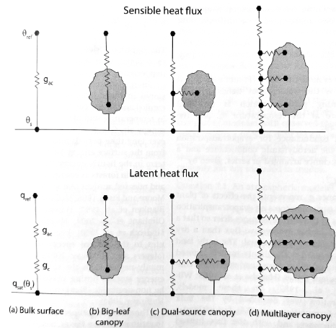
Generalization from bulk surface to canopy
*In-class projects to consider:
More details on big-leaf vs dual-source vs multilayer canopy
Leaf energy budget and temperature
Leaf gas exchange (stomatal physiology) → photosynthesis and stomatal conductance
Equations similar but need to replace temperatures, conductances, vapor pressures etc for the right surface (and different surface structures)
For leaves → need to consider stomatal physiology and biochemistry of photosynthesis
Bonan (2019) Fig. 7.3
Notes:
Big leaf (e.g. Penman-Monteith equation): considers canopy as one big leaf with effective conductance that represents effects of leaf and canopy cover, photochemistry etc
For leaves: need to consider links between energy, water fluxes and CO2. Mathematical implementation couples leaf temperature, energy balance, photosynthesis, stomatal conductance

Slide 14
Additional constraint with soil evaporation
Modify eqn for E with additional term:
Accounts for relative humidity in pore space where water evaporating
Dry layer then affects g_{c} → decreases with increased dryness
→ Parameterized using empirical relationship of g_{c} with soil moisture or dry column height (differs across models)*
E = q_{sat} (T_{s}) – q_{ref}
g_{c}⁻¹ + g_{ac}⁻¹
E = h_{s1} q_{sat} (T₁) – q_{ref}
g_{c}⁻¹ + g_{ac}⁻¹
Notes:
As soil evaporation continues, dry soil layer develops on surface
E then depends on rate of diffusion of moisture through this dry layer
Therefore first term on numerator is water vapor concentration in pores where moisture is evaporating
Empirical relationships can depend on soil texture etc and can also depend on differences of diffusivity of moisture through air or soil
Other parameterizations adjust E for presence of litter

Slide 15
Canopy storage
Heat stored in plants and canopy air
Typically negligible over long time periods
therefore often ignored in model energy budgets (and obs)
another term neglected is energy stored in photosynthesis

Slide 16
Soil heat flux (G)
𝜅 = thermal conductivity
T_{s} = surface temperature
T₁ = depth in layer 1
𝛥z = depth of layer 1 etc
Some of R_{n} used to heat soil through conduction
Driven by temperature gradient (high → low T)
Iterative calculation for soil temperature through “discretized” soil layers*
More complex models take into account heat transferred by movement of liquid water*
Different ways to calculate 𝜅 (dependent on soil texture, soil hydraulic properties etc)*
G = 𝜅 (T_{s} – T₁)
^{𝛥z}
Notes:
Thermal conductivity is measure of an object’s ability conduct heat.
Depends upon soil texture (sandy vs clay soils for example) and how depth affects compaction of soil, soil wetness (log reln) and any soil freezing

Slide 17
Surface temperature
R_{n} balanced by energy lost or gained from H, E, G and canopy storage.
Modulated by T_{s}
Ts calculated from Energy balance eqn. (Eqn 7.13) → but it’s non-linear
Fluxes depend on T_{s}, but T_{s} itself depends on G
Rearranged:
Need numerical methods to solve*
(1- 𝜌_{s} )S↓ + 𝜀L↓ = 𝜀𝜎T_{s}⁴ + H(T_{s}) + E(T_{s}) + G(T_{s})
Notes:
Non-linear in dependence of outgoing longwave radiation and latent heat flux dependence on saturation vapor pressure deficit and then gac also a function of E and H separately.
Need numerical methods to solve because Outgoing L, E and H depend on Ts, and gac a function of E and H so also depends on Ts.
Calculate Ts from energy balance equation having already calculated energy fluxes. Iterative solutions OR combine energy balance and surface temperature calculations together and solve simultaneously so all variables are calculated together at t+1 (implicit solution)
Numerical methods approximate solution because it’s difficult to solve analytically (to get an exact solution). Use an algorithm to solve.

Slide 18
Additional modeling issue
T_{ref} and q_{ref} → climate forcing inputs in static mode
BUT in coupled ESM mode ➔ need to solve for atmospheric circulation as well

Slide 19
Recap: Factors modulating surface energy fluxes
Changes in air temperature, humidity and net radiation
Changes in precipitation (moisture availability)
AND vegetation/surface properties
Surface roughness
Wind speed
Vegetation type
Leaf area index
Soil moisture
→ Through impact on conductance…

Slide 20
Bowen ratio
B = H / E
Often cited metric of surface energy balance → MIPs

Slide 21
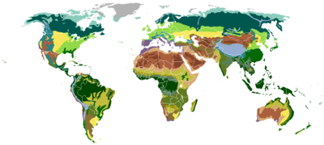
Geographic variation of surface energy fluxes
Annual ET decreases from equator towards poles
Bowen ratios:
Tropics: 0.1-0.3
Temperate forests and grasslands: 0.4-0.8
Semi-arid regions: 2 - 6
Deserts: > 10
Notes:
Balance between radiation needed to evaporate and precipitation to provide moisture to evaporate. Tropics generally has high radiation and moisture.
Often talk about moisture limited or energy limited ecosystems

Slide 22
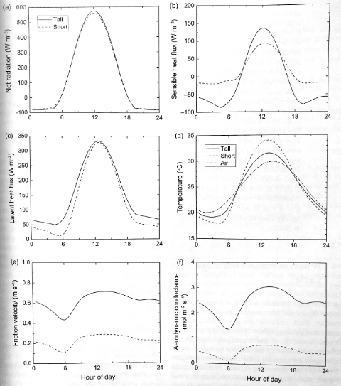
Diurnal cycles
Bonan (2019) Fig. 7.5

Slide 23
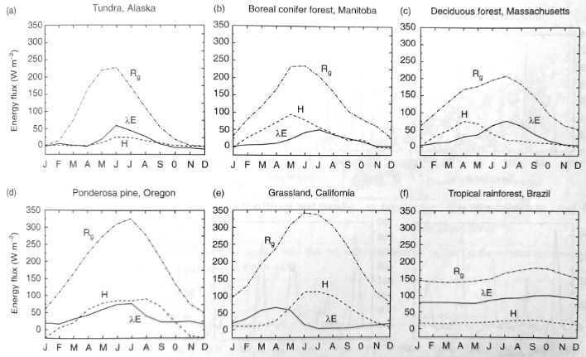
Annual cycles
Bonan (2016) Fig. 12.3

Slide 24
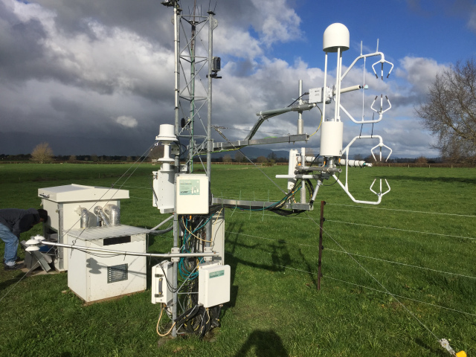
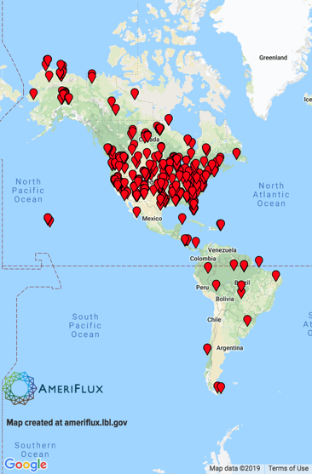
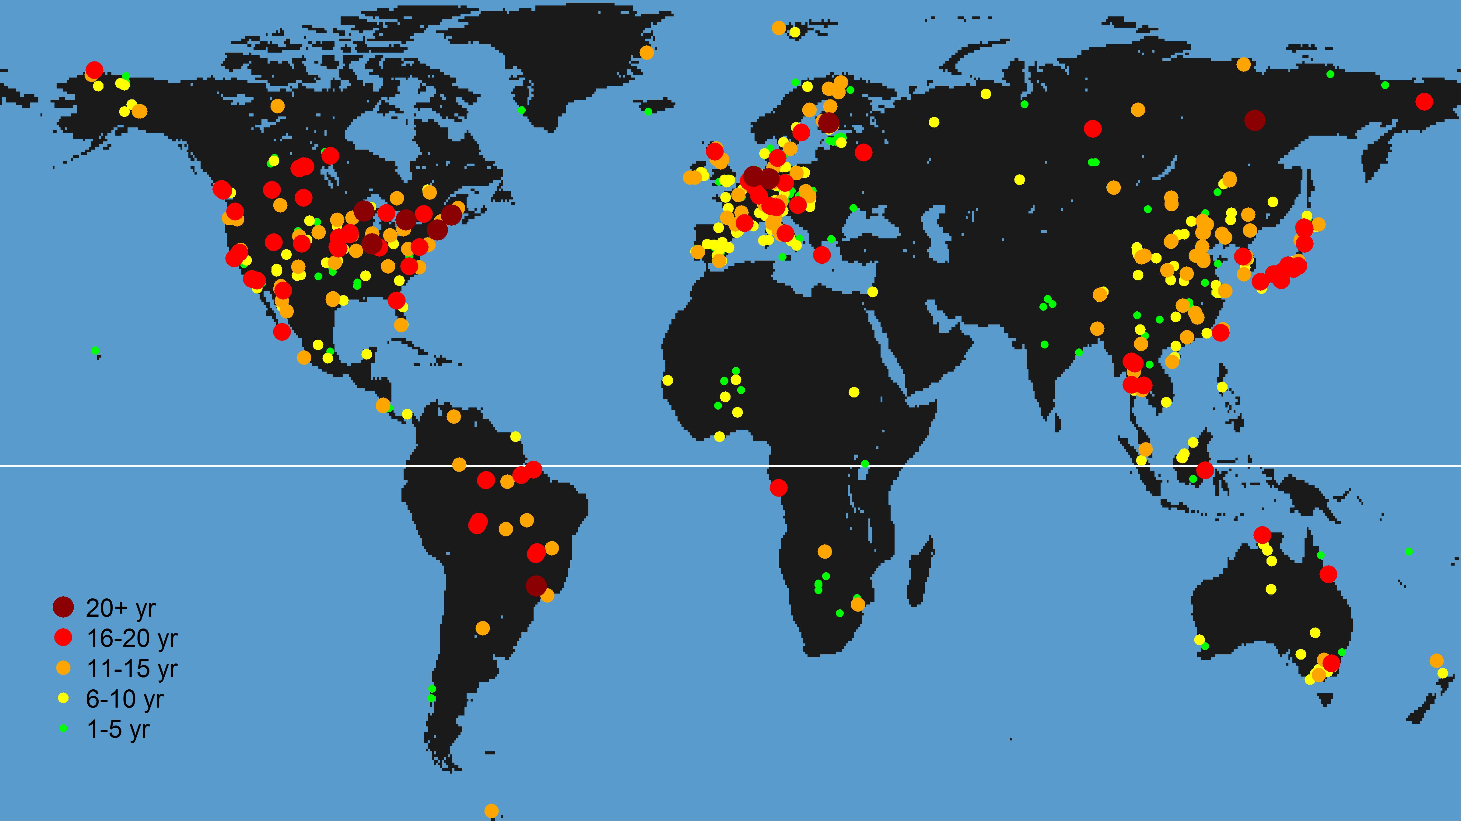

Model evaluation*
Eddy covariance → measurements of H, H and net CO₂ fluxes
Issue with energy balance closure in both model and obs
https://fluxnet.fluxdata.org
https://ameriflux.lbl.gov
Notes:
Energy balance closure issues: methodological, failure to account for storage terms and landscape heterogeneity (not knowing exactly where fluxes come from and assumptions and surface cover and topography etc).
Can correct based on Bowen ratio → not affected by energy balance closure

Slide 25
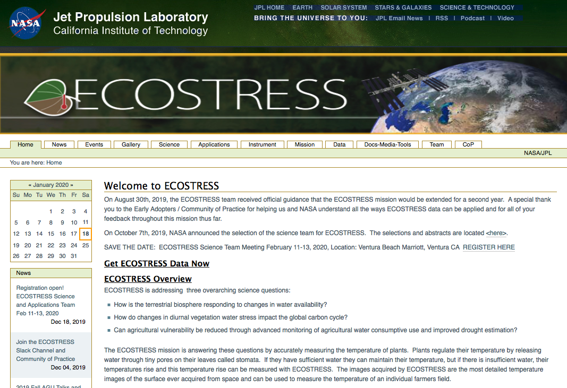
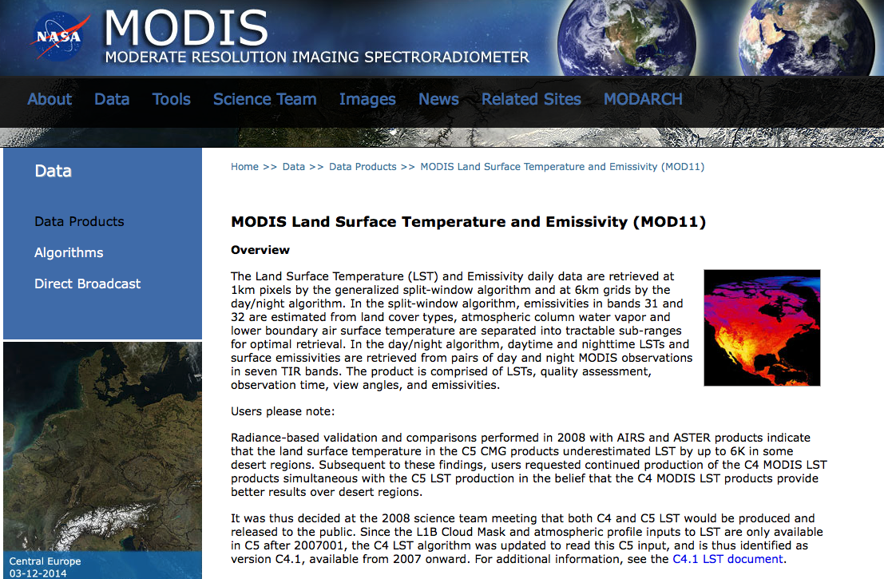
Model evaluation*
Satellite products of surface temperature and evapotranspiration

Slide 26
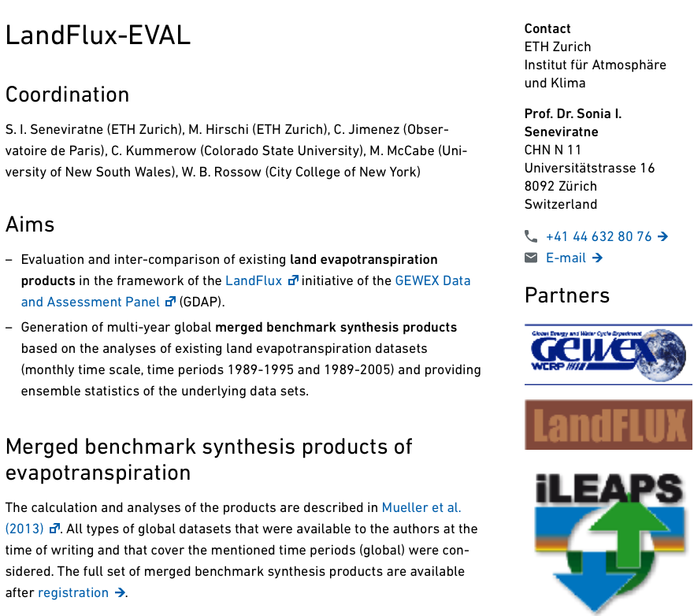
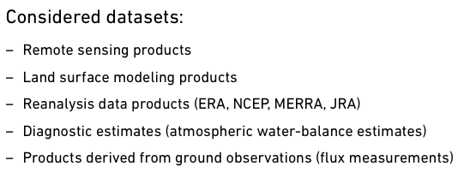
Model evaluation*
LandFlux-EVAL
https://iac.ethz.ch/group/land-climate-dynamics/research/landflux-eval.html

